Slide 1


Linux File Access Control
Ben C. Roose
    Electrical Engineering & Computer Science
    Systems Administrator, Wichita State University
Maintain Debian, Ubuntu, and Linux Terminal Server Project Labs
Notes:
Dr. Jadliwala is away due to an emergency, but I'm giving a talk on File Access Control which I gave at a previous Kansas Linux Fest conference
Introduce me!

Slide 2

What are we talking about?
We will look at:
DAC in Linux/Unix
Basics of the Linux filesystem and I-nodes
Relationship between I-node tables, files, and directories
Hard links and soft (symbolic) links
Examining a past exam question from CS 766
Live demo if time allows!
Notes:
Quick run down of what we will talk about over the next 40 minutes!

Slide 3
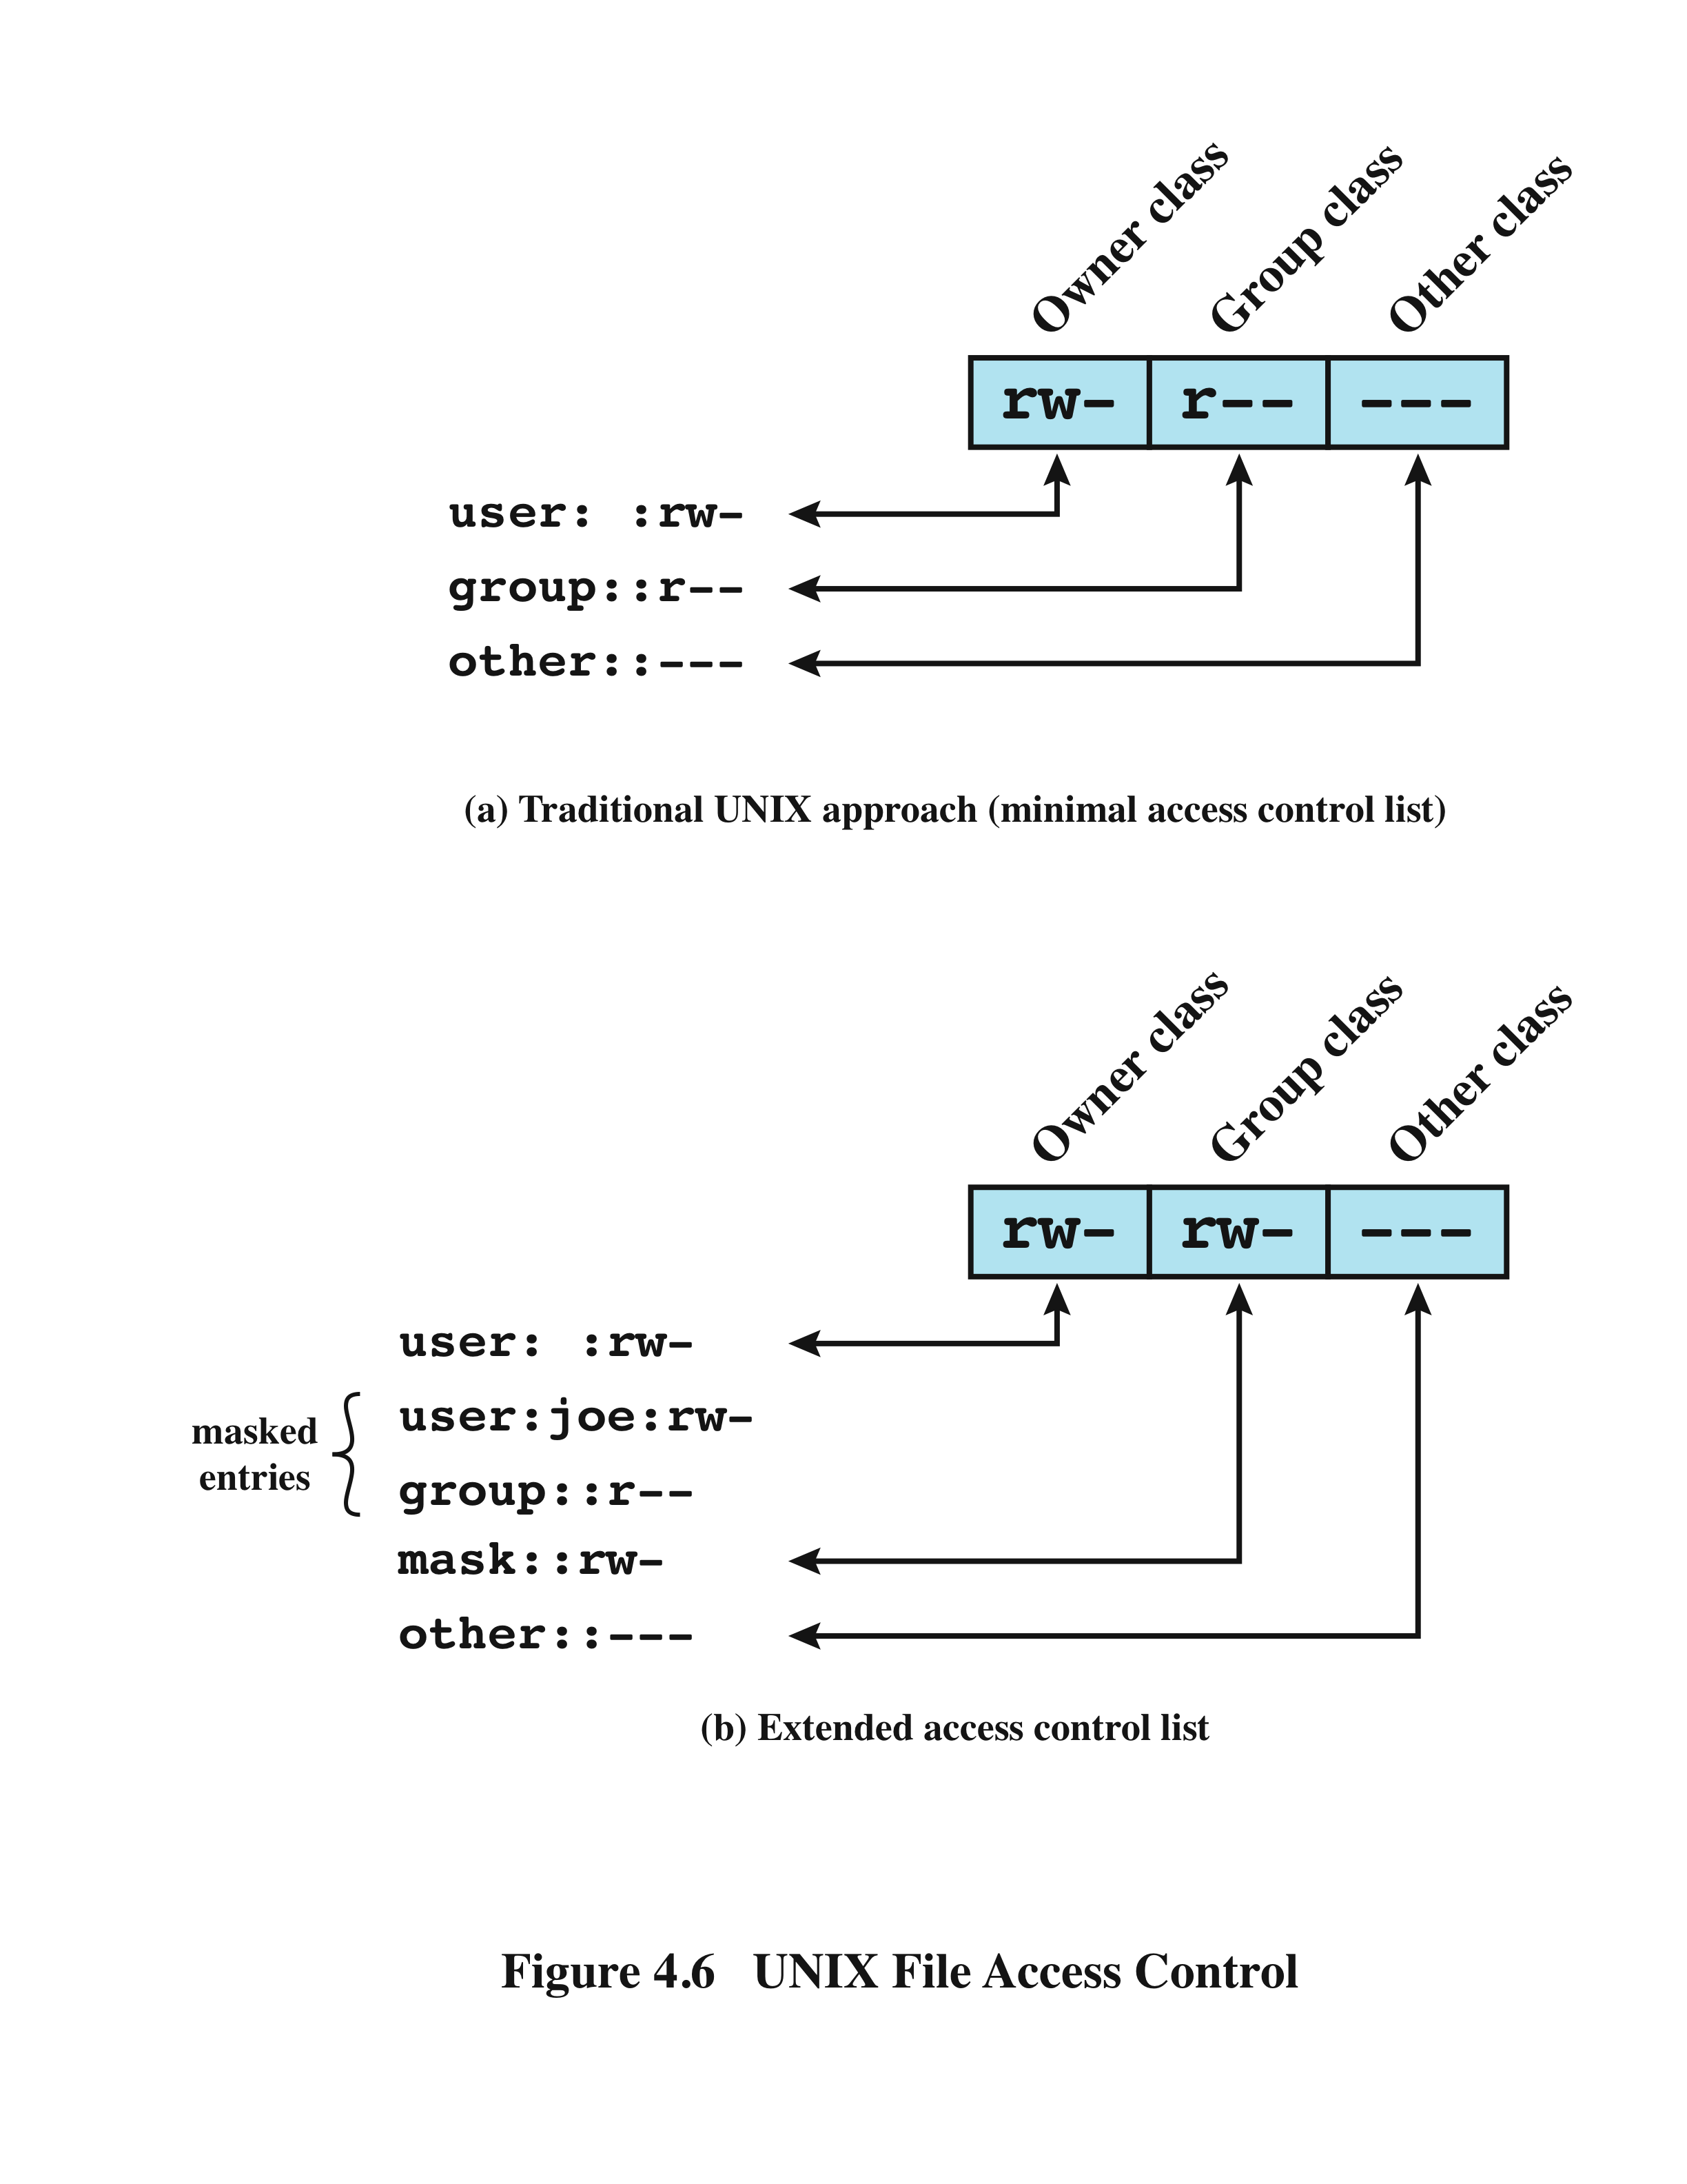
Discretionary Access Control in Linux
Linux OS is designed to be a multi-user system under Discretionary Access Control (DAC)
Users should be given the least privilege to complete their required task
Traditional UNIX file access control use 12 permission bits
Modern Linux OS can use extended Access Control Lists (ACL) if required
From: Conklin, A. White, G. Principles of Computer Security, 4th edition (p. 126)
Notes:
Basics of Linux as a DAC model.
Talk about root = GOD, and use of least privilege
Briefly mention extended ACLs
How many of you have played around and used Linux before?

Slide 4
Linux File Access Control
This is not a direct discussion on:
User/Group/Other Permissions
Set UID, Set GID, and history of the Sticky Bit
Octal numbers and base 8 calculations
/etc/passwd, /etc/shadow, /etc/group, /etc/gshadow
adduser versus useradd
usermod, groupmod, chmod, chown, chattr, umask
For help on all the above, I suggest...
man and info pages, Google Searches, Linux Forums, Linux Documentation Project: http://www.tldp.org/, and Tutonics tutorial:
http://www.tutonics.com/2012/12/linux-file-permissions-chmod-umask.html
Notes:
I am not going to talk too much on the commands you use to make user and permission changes in Linux. I wish to focus on why these file permissions work.
I have given you a hand out on some of the basics about Linux File Access and using chmod to help you with your homework tonight!

Slide 5
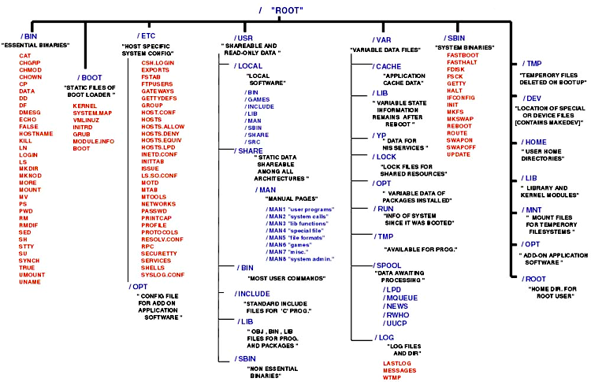
Mount Points and Directory Structure
Linux uses an m-ary tree structure for directories and files, known as the File System Hierarchy Standard (FHS)
From:ACL Wikipedia, Cornell University. (2008). Linux Directory Structure
Notes:
All directories and files “hang” from the root (/) directory in Linux, including disk partitions and network shares
It all boils down to files

Slide 6
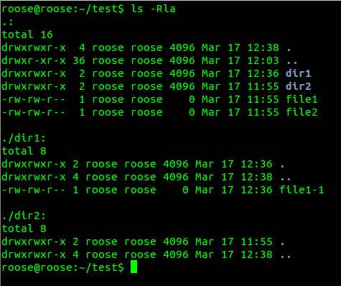
Example on the Terminal: $ ls -Rla
Notes:
I like green on black, reminds me of childhood with dad's Amstrad word processor in '80s!
What does $ ls -Rla do?
What do the single and double dot do?
Files – including dirs, and links
Point out: Reg file vs. directory
File permissions – user/group/other
Link count
Ownership – user/group
Modification Timestamp
Why do directories have a link count of 2?
File/Dir Size (4096 = 4 Kbytes)
Total = number of disk blocks used (unit in which data is stored/retrieved on fixed block architecture disk)

Slide 7
Common Filesystem Types
Popular Linux Native Filesystem Types:
Ext2fs: Second Extended File System / Dominant in late 1990s
Ext3fs: Similar to Ext2fs, but adds journaling support
Ext4fs: Can use disks > 16TiB and files > 2TiB / Currently dominant
ReiserFS: Journaling support / Can handle large number of small files
Btrfs: Currently experimental (based on ZFS) / May supersede Ext4fs
Popular Non-Linux Native Filesystem Types:
FAT: File Allocation Table from DOS days / still supported by most OSes
NTFS: New Technology File System / M$ Windows XP and beyond
HFS/HFS+: Hierarchical File System / Apple Mac OSX
ZFS: Zettabyte File System / Sun Microsystems / Used in FreeBSD
ISO-9660: CD-ROM standard (similar to FAT)
UDF: Universal Disc Format / Used for DVD-ROM and BLU-RAY
Notes:
Different filesystems store data differently.
We are going to look into how the Linux Extend filesystem stores files and directories
(What is journaling?)
Let's look at how Ext2 works to keep things simple!

Slide 8
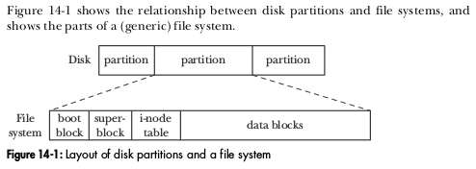
Basics of a Filesystem
A filesystem sits on a disk partition, and contains all of the data structures needed to logically store directories, files, and the data contained inside.
From: Kerrisk, M. (2010). The Linux Programming Interface (p. 255)
Notes:
Filesystems are stored on disk partitions (can be physical disks, such as a hard drive, or virtual disks, such as LVM Logical Volume)
Data from files are stored in data blocks (remember the ls listing showing total blocks used)
CLICK:
Info on each file is stored in the i-node table

Slide 9
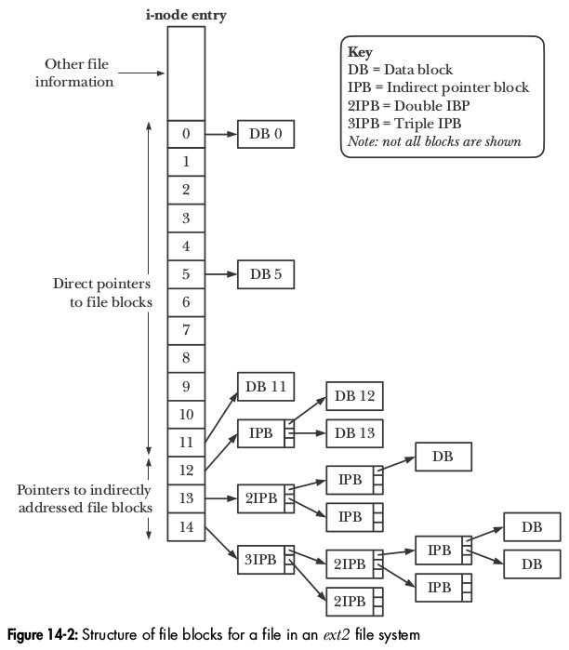
Ext2 I-Node (inode) Entry Structure
I-node structure has fixed size, while files can be an arbitrary size!
12 Direct Data Block Pointers
3 Indirect Data Block Pointers
Max file size allowed
(for a 4096 byte data block size)
= approx. (1024)³ * 4096 bytes
= 4 Terabytes!
Where are the file permissions and ownership information stored?
From: Kerrisk, M. (2010). The Linux Programming Interface (p. 258)
Notes:
Data stored in Data Blocks.
Small files can fit into the first 12 direct data blocks
Large files use indirect pointer blocks to store additional pointers to data blocks
Each IDP can store 256-1024 pointers (depending on block size from 1024byte to 4096byte block size)
Allowing for noncontiguous block storage and random access to blocks
CLICK: Where are file permissions stored?
CLICK: In here!

Slide 10
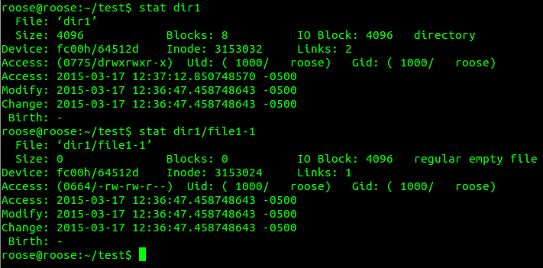
Example on the Terminal: $ stat
Notes:
Stat shows the inode entry for a file, here we have a regular file and a directory
Point out: Access permissions
File size and blocks used
Links?
I-node number – like a database key field@!
What is inode number compared to the filename?

Slide 11
Relationship between I-node and directory
I-Node Table
File Data (Data Blocks)
I-node #: | Type = directory
3152901 | ...
 | Data block pointers
I-node #: | Type = directory
3153032 | ...
 | Data block pointers
I-node #: | Type = regular file
3153024 | ...
 | Data block pointers
~/test directory
. | 3152901
.. | 3014658
dir1 | 3153032
dir2 | 4194370
file1 | 3153027
file2 | 3153030
~/test/dir1 directory
. | 3153032
.. | 3152901
file1-1 | 3153024
~/test/dir1/file1-1 file
File data
Notes:
Directories are just files which contain a table in their data blocks of directory listing associated with I-node #
Follow the path via I-node numbers just as the Linux system does!
Each pathname/inode # pair is a hard link in the system
(look back at the stat example and point out the link counts!)
What about this guy, (..) where does he point?
And what about this guy, (.) where does he point?

Slide 12
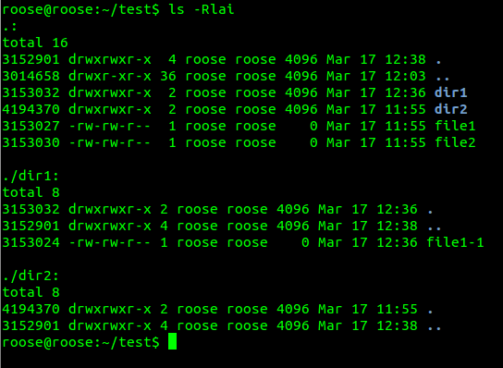
Example on the Terminal: $ ls -Rlai
Notes:
Let us revisit our directory listing, but look at the I-node numbers.
Point out: How the I-node numbers correspond to the directory listings (i.e. dir1 and . inside dir1 are same #)
Link counts for directories (notice the 2, 4 and 36)
Link counts for files = 1, why?
ACADEMICALLY, Ben, this is quite interesting, but how does it affect us as Linux users??

Slide 13
Hard Links Versus Soft (Symbolic) Links
I-Node Table
File Data (Data Blocks)
I-node #: | Type = regular file
3153024 | ...
 | Link count = 2
 | Data block pointers
I-node #: | Type = symlink
4194431 | ...
 | Link count = 1
 | Data block pointers
~/test/dir1 directory
. | 3153032
.. | 3152901
this | 3153024
~/test/dir2 directory
. | 4194370
.. | 3152901
that | 3153024
the_other | 4194431
data for soft link
~/test/dir2/other
“../dir1/this”
(symlink can be absolute or relative pathname)
Notes:
Well, this leads into how this affects us in the real world as system administrators.
What is the difference between a hard link and a soft (or symbolic) link?
Point out: The difference between a directory listing and a link within the data blocks of the file
Notice the link counts
What happens when link count =0?!
Symlinks - Mention Windows shortcuts are like symbolic links
NOTE: symlinks can contain absolute (from root path) or relative pathnames

Slide 14
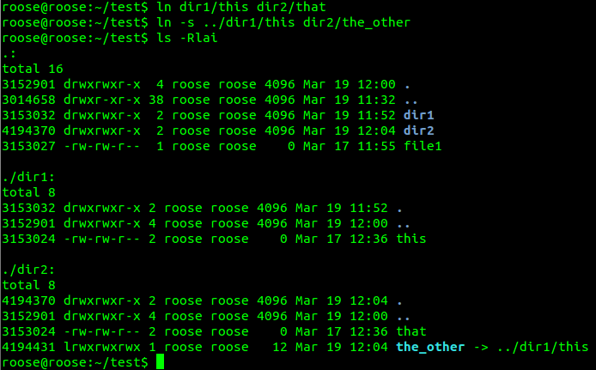
Example on Terminal: $ ln vs. $ ln -s
Notes:
Point out: How the I-node numbers correspond in this and that (as do the permissions)
the_other does not share I-node numbers
Notice the file type is link (l) not regular file (-)
Notice the creation date difference in this, that versus the_other
Why can we not create hard links across multiple filesystems?
Why can we not create additional hard links for directories?
So why use a hard link rather than a soft link?
Data duplications + symlink fails on tarket rename/removal!

Slide 15
File Access Control Exam Question
Adjusted exam question from a Computer Security class (CS 766) at Wichita State University a few years ago:
A regular text file is created in a Linux system by the root user.
User “joel” is granted ownership of this file with the following permissions: rw-rw-r--
Does joel have the ability to change the text in the file?
Does joel have the ability to delete the text file?
- reproduced with permission of Dr. Murtuza Jadliwala (EECS, WSU)
Notes:
Yes, Joel does have ability to write into the file
Deleting is trick question, we do not know!
We need to know the permissions of the containing directory

Slide 16
Example on the Terminal: Exam Answer
Live Terminal Demonstration
by Ben if time allows!
Notes:
Ben list the commands here
Mkdir testdir
Cd testdir
Touch testfile
Ls -al
Chmod u-w .
Chmod 777 testfile
Ls -al
Less testfile
Rm testfile (permission denied)
Chmod 777 .
Chmod 000 testfile
Ls -al
Less testfile (permission denied)
Rm testfile (successful)

Slide 17

Kansas Linux Fest 2017
WuLUG
(WSU Linux User Group)
Sat & Sun, May 13 & 14, 2017
Devlin Hall, WSU
kansaslinuxfest.org
Meeting tonight and every two weeks on Tuesdays, 5:30-7pm,
JB 205/206 (Linux Lab), WSU
facebook.com/wulug
IRC freenode: #wulug
Notes:
Mention KLF 2017 a Linux and open source conference on campus: looking for attendees, speakers, and volunteers for next year)
Mention WuLUG tonight in Linux Lab. Scheduled hack night to help users install Linux (bring your laptop), and we can help if you are stuck on the CS 766 homework!

Slide 18

Thank You!
Ben Roose: ben.roose@wichita.edu
Any Questions?

Slide 19



Please attribute
Ben Roose, EECS, Wichita State University
This work is licensed under the Creative Commons
Attribution-ShareAlike 4.0 International License.
To view a copy of this license, visit http://creativecommons.org/licenses/by-sa/4.0/.

